Slide 1
Personaliza los sitios de SharePoint: Branding, Site Designs, Site Scripts
Ruben Ramos – Ferran Chopo

Slide 2


RUBeN RAMOS
FERRAN CHOPO
Arquitecto de soluciones
Jefe
RICOH
www.rubenrm.com
www.ferranchopo.com
rubenr79
fchopo
https://www.linkedin.com/in/rubenramosmateo
https://www.linkedin.com/in/fchopo

Slide 3
Personaliza los sitios de SharePoint
Branding, Site Designs, Site Scripts

Slide 4
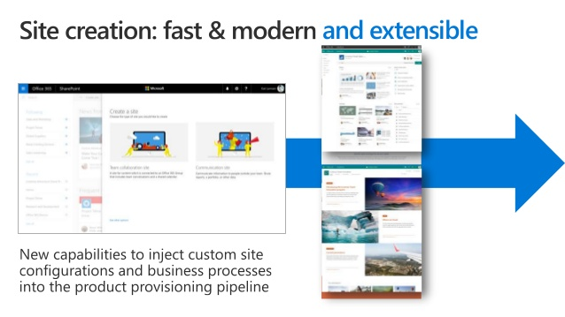
INTRODUCCIÓN

Slide 5
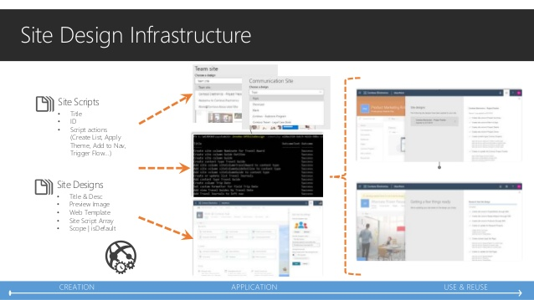
SITE DESIGNS y SITE SCRIPTS

Slide 6
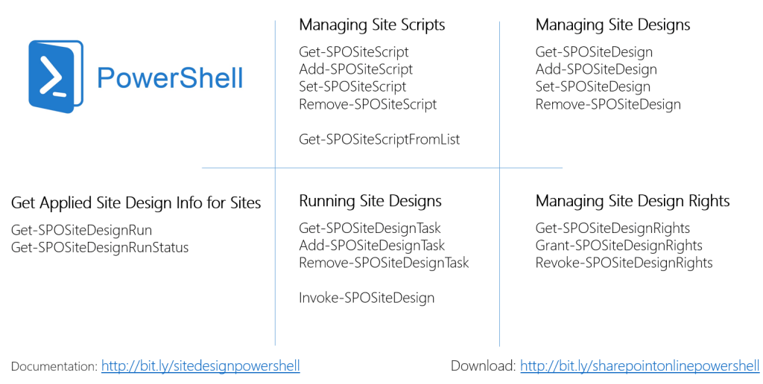
SITE DESIGNS y SITE SCRIPTS

Slide 7
LABORATORIO
Creación de un Site Script y Site Design

Slide 8
LABORATORIO
Trabajando con Site Designs en PowerShell

Slide 9
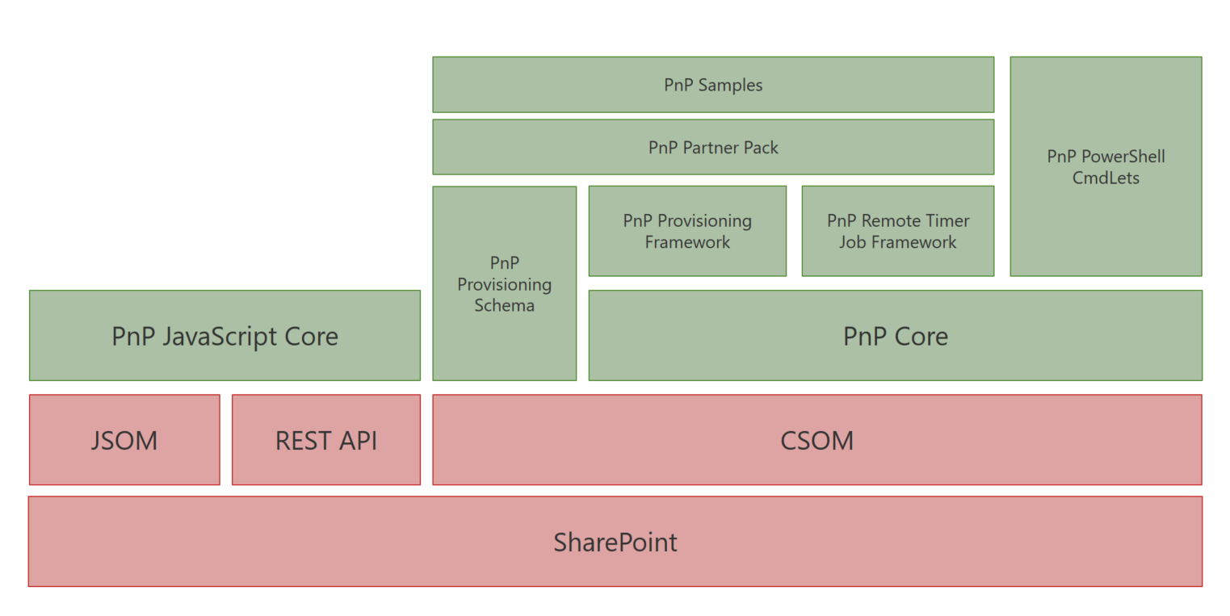
PnP Provisioning Framework

Slide 10
PnP PowerShell

Slide 11
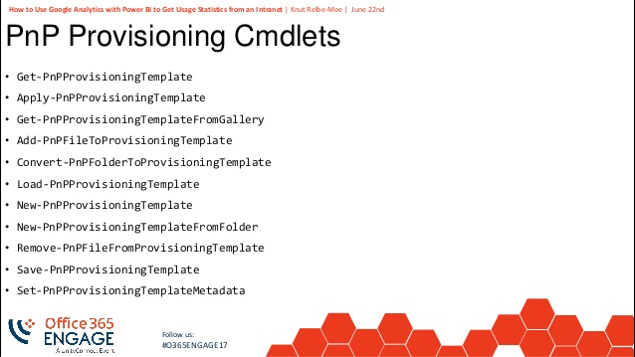
PnP PowerShell

Slide 12
LABORATORIO
Integración con PnP PowerShell

Slide 13
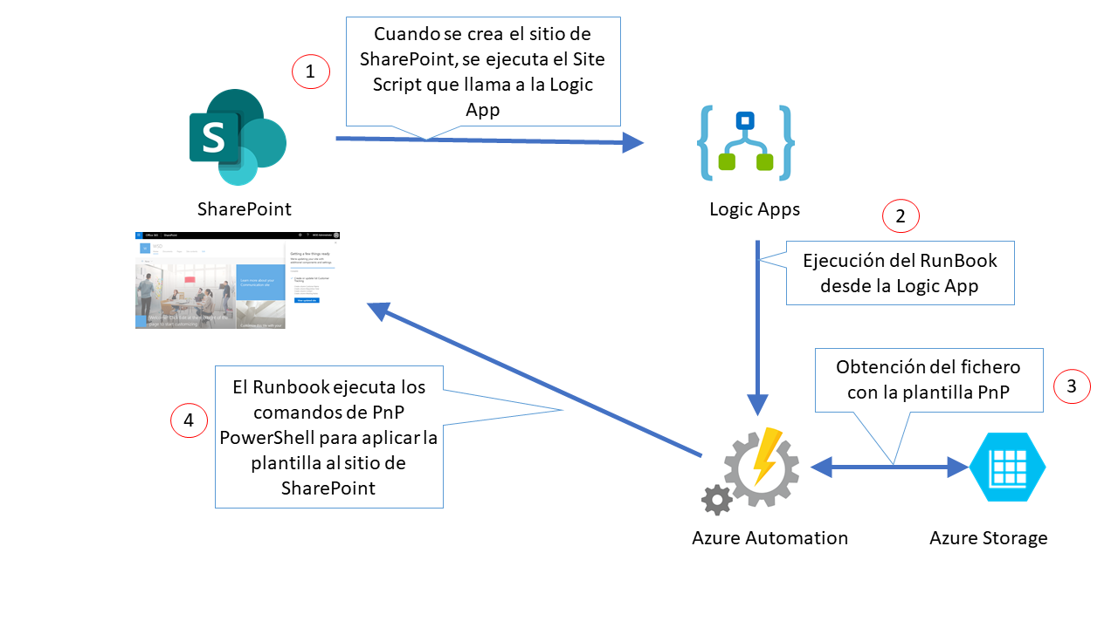
Laboratorio

Slide 14
WiFi keys for attendees
Wireless network: MSFT_GUEST
Login details:
Guest Username: O365Sat@outlook.com
Guest Password: 0195
Needs to be updated!

Slide 23
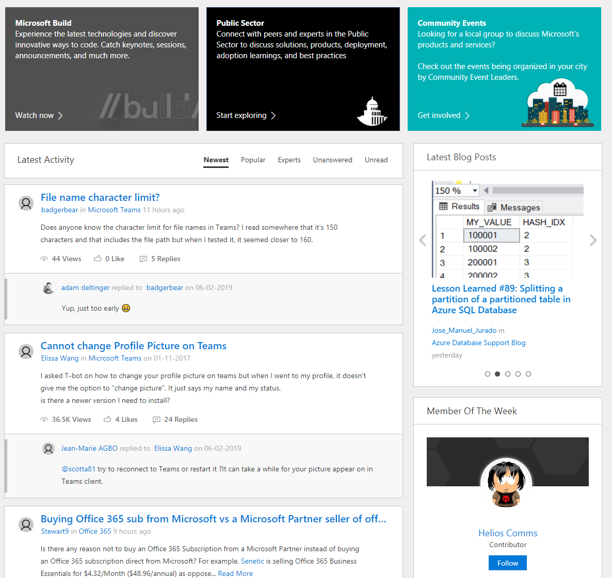
Microsoft Tech Community
techcommunity.microsoft.com
One Microsoft community for IT Pros and tech enthusiasts to learn from experts on Microsoft products
Trusted resource for news, best practices and answers from Microsoft product teams and MVPs
Join today! It’s free – sign in with your Microsoft Account.

Slide 24
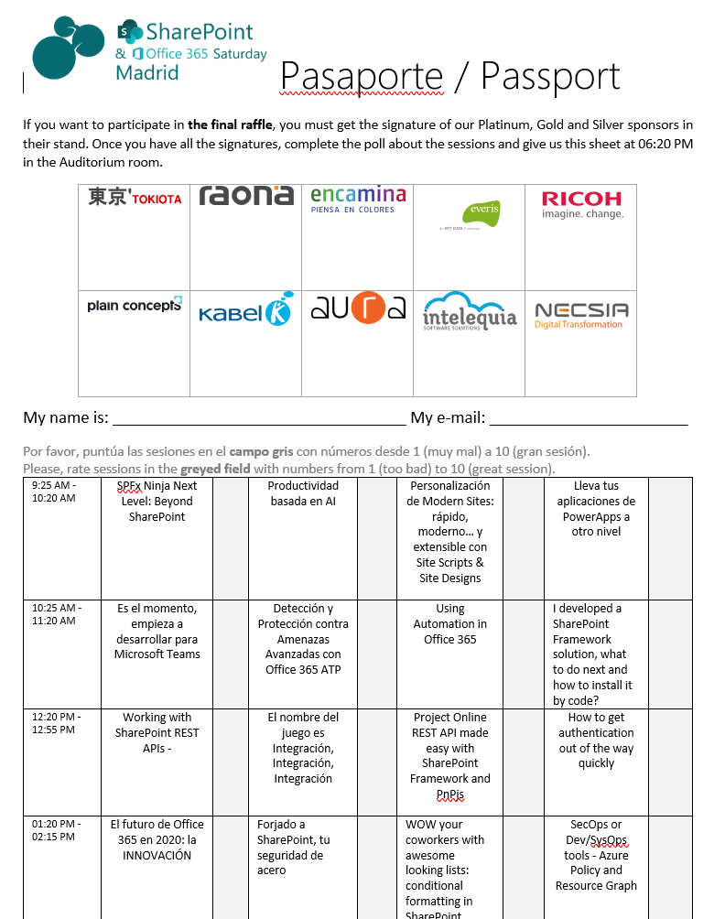








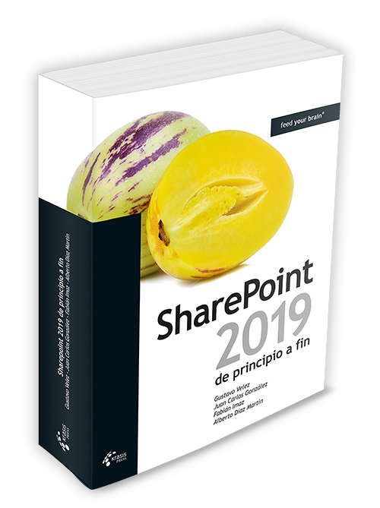
Raffle
Please, fill your SP & Office 365 Saturday Madrid passport if you want to participate.
You can win one of these gifts:
Odor
Odor@winterfell.com
2x
1x
10
1x
Needs to be updated!
1x
9
4x
2x
8

Slide 25
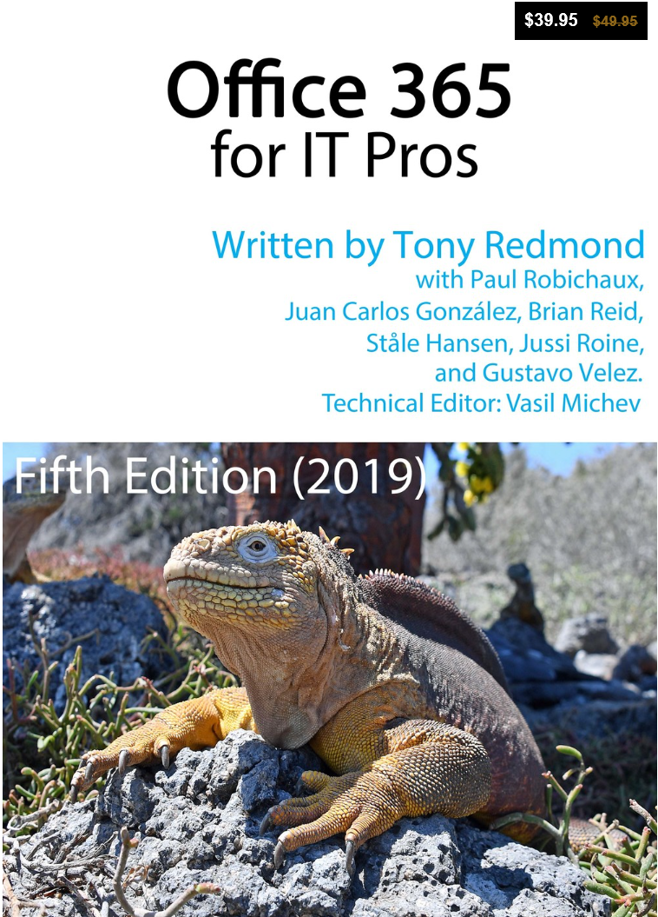
Office 365 for IT Pros
Get a 20 % discount buying the book here:
https://gumroad.com/l/O365IT/Spoisgreat

